Slide 1

FAKE CURRENCY DETECTION
Team Number : 07
Team name and SRN :
Gowri Sriya R V S PES2UG21CS180
Lekhan Saathvik Lekkala PES2UG21CS255
Mangali Bhavya PES2UG21CS277
Hansika Pagadala PES2UG21CS359

Slide 2
Outline
Problem Statement
Dataset Used
Model Proposed
Novelty
Outputs

Slide 3
Problem Statement
The aim of this project is to test the authenticity of Indian currency notes by preparing a system which takes the image of currency bill as input and gives the ﬁnal result by applying various image processing, computer vision, deep learning techniques and algorithms.

Slide 4
Dataset Used
The dataset encompasses images of Indian currency notes across various denominations, including 10, 20, 50, 100, 200, 500, and 2000 rupee notes, providing a comprehensive representation of the currency spectrum.
Our dataset, sourced from Kaggle, serves as a foundational element for our model development. Complemented by manual collection, web scraping, and meticulous curation, this amalgamation enriches the dataset's diversity, enhancing the model's performance in discerning real and fake currency notes.
No of Data points: 218

Slide 5
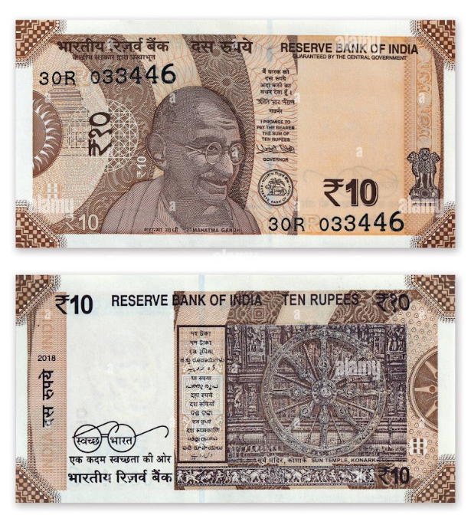
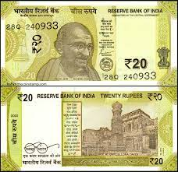
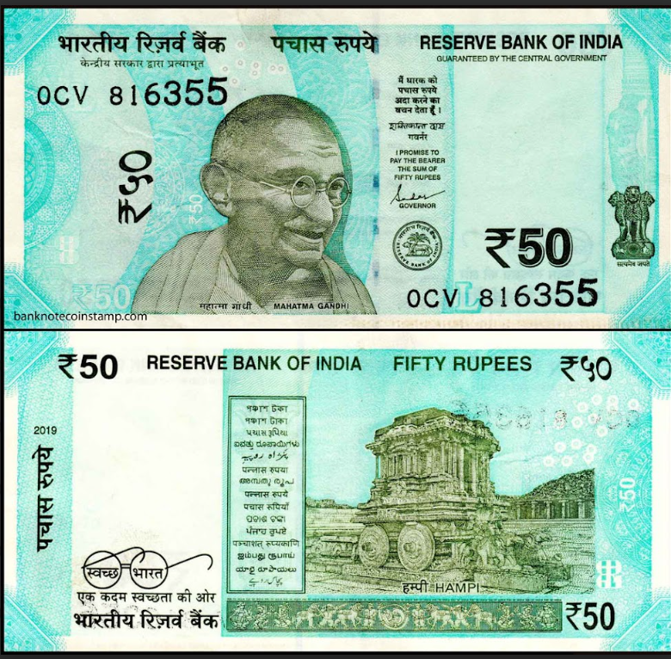
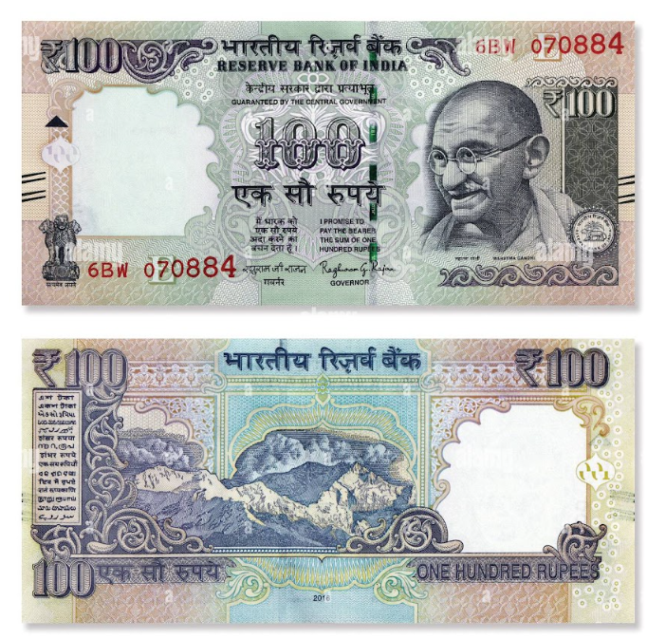
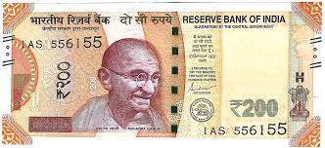
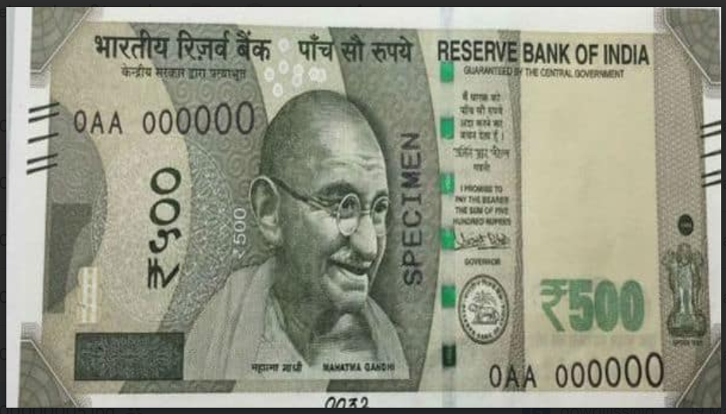
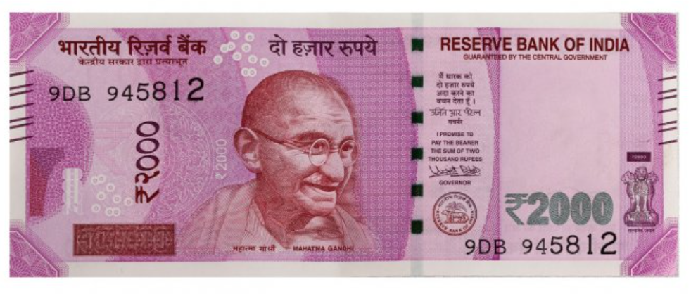
Dataset Used

Slide 6
Model Proposed
Convolutional Neural Network (CNN) is implemented using TensorFlow and Keras for binary classification of currency notes as real or fake.
The CNN architecture consists of multiple convolutional layers followed by max-pooling layers to extract features from the input images.
Convolutional layers are added with 64 filters of size (3,3) and ReLU activation function to learn spatial hierarchies.
Max-pooling layers with pool size (2,2) are used to reduce spatial dimensions and retain important features.

Slide 7
Why this Model?
The models like CNN, ReLU activation, max-pooling layers, and dense layers are used for effective feature extraction and classification in image tasks.
The CNN architecture captures spatial hierarchies, ReLU adds non-linearity, max-pooling reduces complexity, and dense layers aid in classification.
Binary cross-entropy loss suits binary classification.
While RMSprop optimizer adjusts learning rates for improved model performance.

Slide 8
Novelty
Our novelty lies in our meticulously curated dataset, comprising manually collected images and data obtained through web scraping.
This diverse dataset, meticulously compiled and curated, enhances model robustness and generalization, ensuring comprehensive coverage of real and fake currency notes.

Slide 9

Output
Output Screenshots:

Slide 10
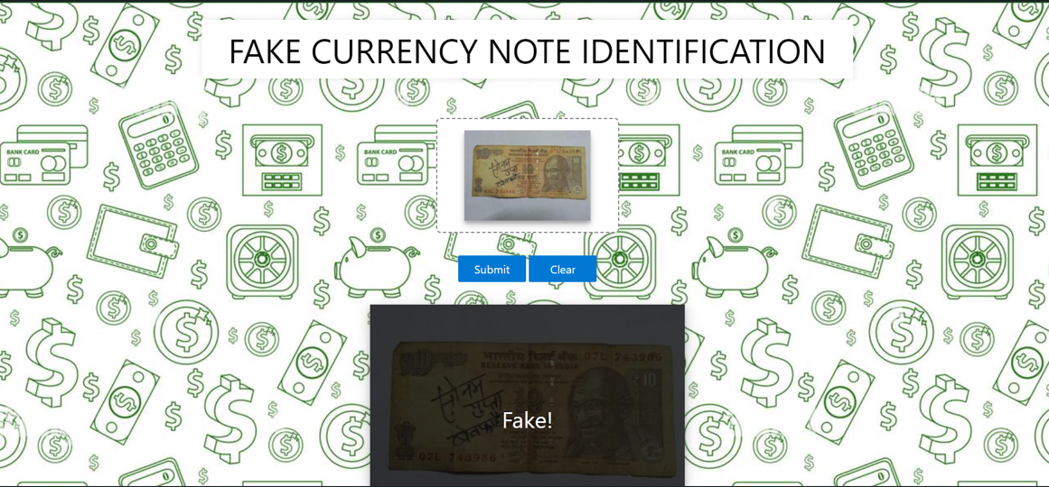

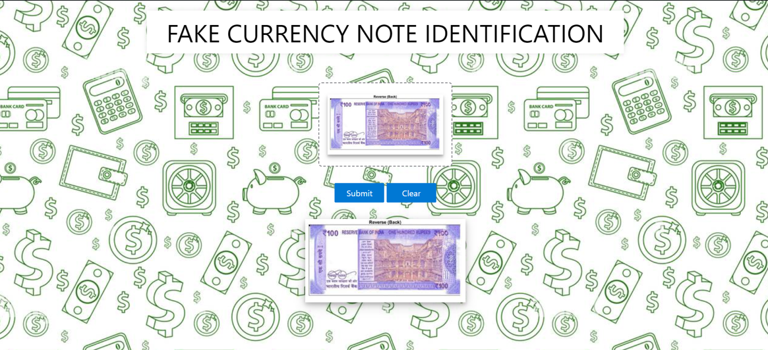
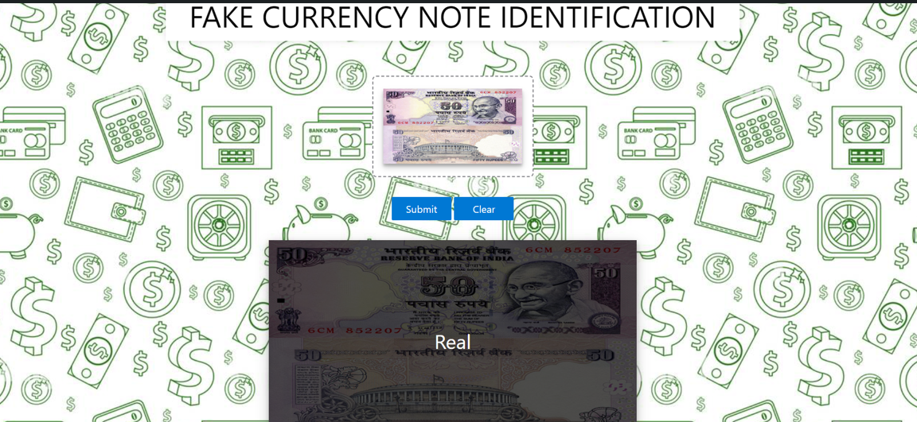
Output

Slide 11
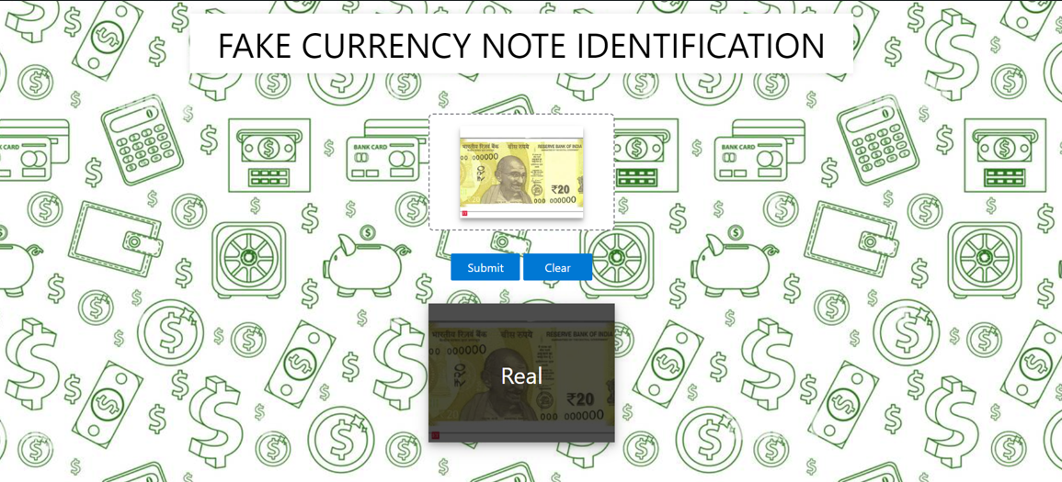
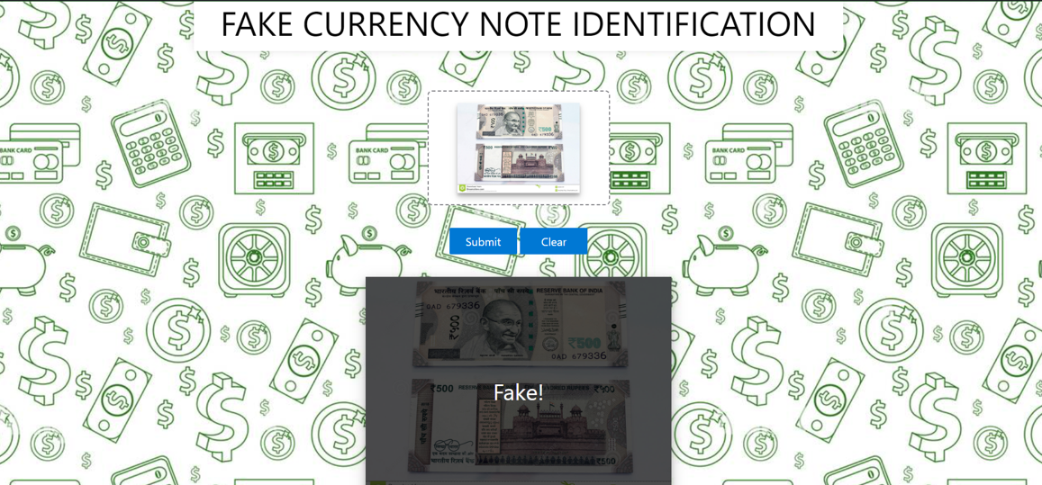
Output

Slide 12
THANK YOU

